Slide 1

Day 3
SNA and R

Slide 2
Awesome Network Analysis Resources
https://github.com/briatte/awesome-network-analysis#datasets

Slide 3
Preliminaries (Redux)
What is a graph?
A set of vertices with lines between pairs of vertices
What is a network
A network is a graph where we add attributes to make the graph more sensible
Graphs or networks have three main components important for visualization
Vertices and nodes
Lines
Layout
Notes:
The first fundamental concept is what is a graph? A network is a special kind of graph.
A graph is
A network is a
We need to think about vertices and nodes, lines and layout

Slide 4
Networks can vary through
nodes
edges
layouts

Slide 5
Node Types: Unimodal
All entitles are the same type
Student 1
Student 2
Student 3
Example: students in a university

Slide 6
Multimodal (“bipartite network”) Entitles are of different types
Student 1
Anna
Student 2
Different Type
Notes:
Profe represent one type of node, students are a different mode
Students at a university are bound to professors

Slide 7
Undirected – lines are called “edges”
Student 1
Anna
Student 2
EDGE
EDGE
Directionality is not a salient feature of the network
Notes:
The link between the two entitles would be referred to as an edge

Slide 8
Directed – lines are called “arcs”
Student 1
Anna
Student 2
ARC
ARC
Notes:
The reciprocity of the line (link or tie) is an important feature of the network

Slide 9
Arc Edges
Weighted
Unweighted
(a.k.a. dichotomous or binary)
Notes:
Weighted versus unweighted
An unweighted network (“dichotomous or binary”)— edge takes one of two values – there can be no edge which is a 0 or an edge can be present = 1
Weighted network edge takes infinite values – more info and gives a sense of how strong the tie is
Recall a third edge type – loop – person nominates themselves

Slide 10
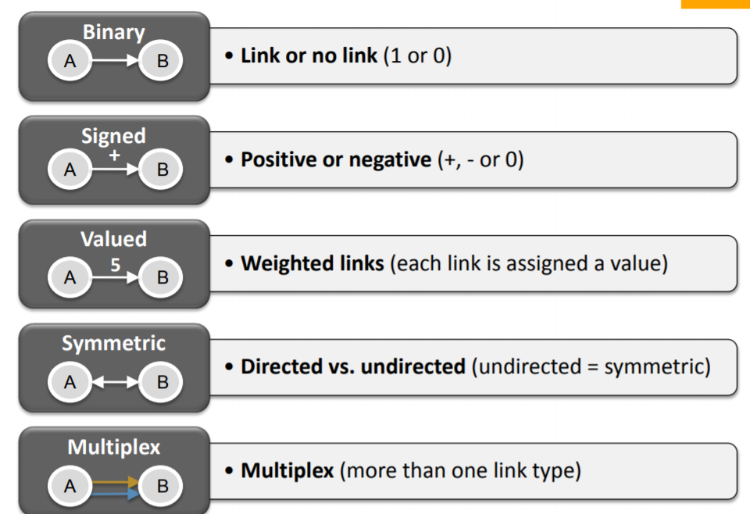
Link types
Notes:
Networks can differ in terms of their links or lines

Slide 11
Aesthetics: Layout
Notes:
Hierarchcial or spring layout – no clear hierarchical structure, things are more centralized, no clear rank order

Slide 12
Visualization Aesthetics
In network maps, as in other visualization formats, several key elements control the outcome.
Color, size, shape, and position
Modern graph layouts are optimized for speed and aesthetics.
They seek to minimize overlaps and edge crossing and ensure similar edge length across the graph.
The main concern in designing a network visualization is the purpose it has to serve.
What are the structural properties that we want to highlight?
What are the key concerns we want to address?

Slide 13
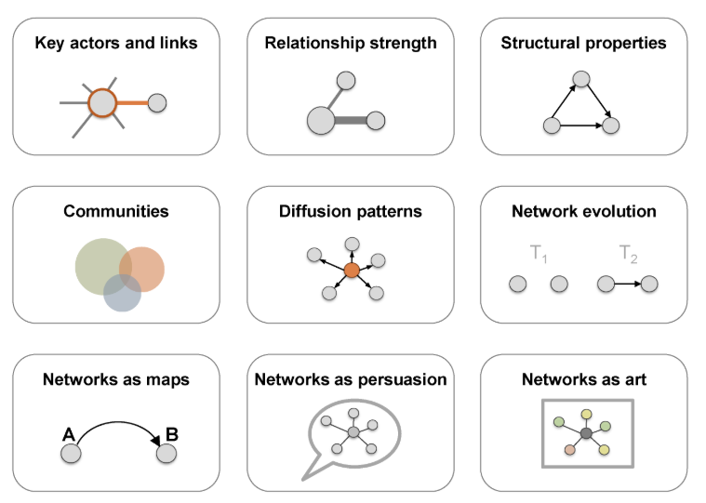

Slide 14
Network representation formats
Network maps
Statistical charts
Heat maps
Sankey diagrams
Spatial representations

Slide 15
Working with Network Data

Slide 16
Data Structures
Two main data structures when getting data into R
1. Adjacency matrix
2. Edgelist

Slide 17
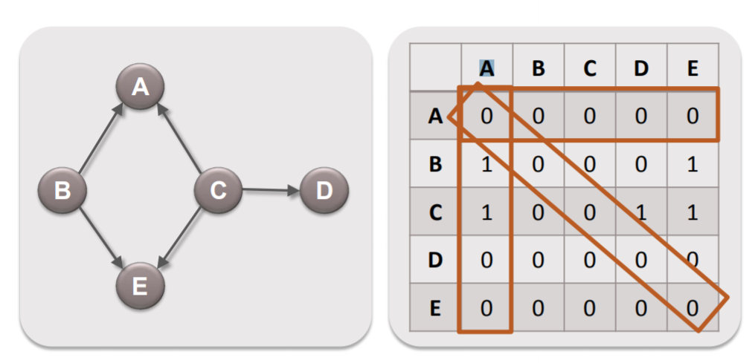
Adjacency Matrix Representation: Directed
Notes:
—shows how adjacent one node is to another through a value (e.g. 0s and 1s)
Advantage – allows us to do mathematical manipulations directly to the network so we can transform the network- when we transform the network as we are visualizing it is calculating it as a matrix
Disadvantage: not intuitive when collecting data, they are “expensive” data structures – more efficient human friendly representation and then let computer turn it into an adjacency network

Slide 18
Example
A network represented as an edge list
Vertex 1 | Vertex 2 | Strength
Ann | Bob | 10
Ann | Carol | 1
Carol | Ann | 5
A network represented as an edge list
Vertex 1 | Vertex 2
Ann | Bob
Ann | Carol
Carol | Ann
Network data: One data representation for network data is called an “edge list” as shown in the top figure. Like its name suggests, it is simply a list of all edges in the network
Like attribute matrices, each row represents an individual in the network. However, unlike attribute matrices, each column also represents an individual
A network represented as a matrix
 | Ann | Bob | Carol
Ann | 0 | 1 | 1
Bob | 0 | 0 | 0
Carol | 1 | 0 | 0
Is this a directed network or an undirected network?
Notes:
Individuals in the Vertex1 column “point to” those in the Vertex2 column in this network.
Additional columns containing attribute data could be used to describe each edge. For example, an Edge Weight column could be added with values representing the strength of various ties.
The bottom table is the same data in a different representation called a matrix.
This network is a directed network, as it is not symmetrical (i.e., Ann points to Bob in row 1, but Bob doesn’t point to Ann in row 2). If it were an undirected network it would be a symmetric matrix; if Ann points to Bob then Bob must necessarily point to Ann.

Slide 19
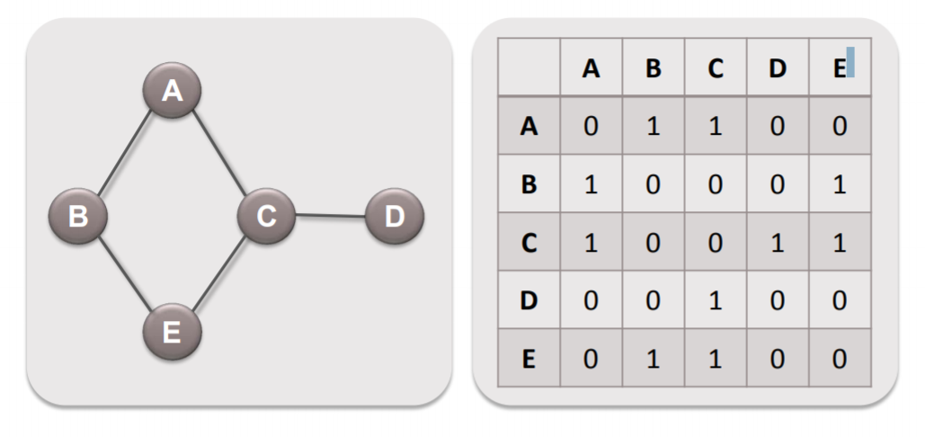
Adjacency Matrix representation: Symmetric

Slide 20
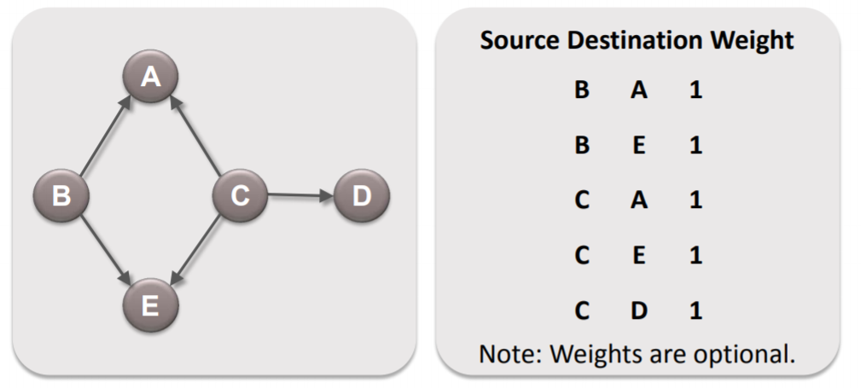
Edge List Data Format
An edgelist has three components
A sender who is initiating time
A target- receiving tie
A weight – strength of that tie
Notes:
R will turn this format into an adjacency matrix for us…

Slide 21
Some strategies for network data collection
Ego Networks
Can use standard sampling techniques (e.g. random sample)
Each respondent describes their own relationships (name generators).
Complete Networks
Each respondent reports their own relationships within the network.
Could use a roster that people use to identify contacts
Cognitive Social Structures
Ask not only for a person’s own relationships, but also for perceived relationships between other people in your population.
Snowball Sampling
Individuals included in the sample identify contacts (friends, sexual partners, etc.) who are added to the study at the next step
Secondary Data
Social media

Slide 22
Sources of Social Correlation in Networks
Influence: An individual performing an action can cause her contacts to do the same
By providing information
By increasing the value of the action to them
Homophily: Similar individuals are more likely to be friends
Two criminologists are more likely to know each other than two random people
Environment: Influence from external elements
Friends are more likely to live in the same area, thus attend and take pictures of similar events, and tag them with similar tag

Slide 23
Network analysis metrics
Aggregate Networks Metrics
Density: cohesion, solidarity, membership
Degree centrality
Betweenness centralities
Do people “bridge” others on the boundary?
Closeness Centrality
How close are people to others?
Clustering Coefficient
How connected are my “friends”?
Notes:
Another set of metrics identifies individuals’ positions within a network. Paramount among these is the set of centrality measures, which describe how a particular vertex can be said to be in the “middle” of a network.

Slide 24
Tools for network analysis
Python, R or other programming languages and the application programmer interfaces (API)
Single tool designed for nonprogrammers
NodeXL
Gephi
Notes:
A powerful set of tools for those who can master the demands of python or other programming languages and the application programmer interfaces (API) that give sophisticated users special access to resources
single tool designed for nonprogrammers, NodeXL, because of its relative ease of use, support for rich visuals and analytics, and integration with the ubiquitous Excel spreadsheet software.
for the noncoding user, NodeXL may be one of the easiest ways to both manipulate network graphs and get graphs from a variety of social media sources.

Slide 25
SNA in R
Three major packages supporting network analysis
Igraph
Statnet
SNA
Download all packages using the standard installer through RStudio

Slide 26
Food for thought
In thinking about your research goals, consider the following the questions:
what is the central problem of your research and why it is worth investigating,
what phenomenon you are studying, in which context, and what key question(s) do you have about the phenomenon, and
why is SNA potentially useful for addressing the question.
SNA can be conceptualized as a variable for another type of analysis or can be used in and of itself to examine structural relationships/attributes

Slide 27
Follow the steps in the R markdown file with the file that is located here

Slide 28
The Research Question:
Do academic collaborations create new partnerships for faculty and students?

Slide 29
Using:
Dataset 1: A Colleague network “who do colleagues communicate with”?
Dataset 2: A Student network: Who do students work with?

